Slide 1
HNDIT1212: System Analysis and Design
Mr.K.Hariselvakumar
(PGDCS(Pdn), PGDE(OUSL), MCS(CSSL), BSC(Pdn))
ATI-Batticaloa

Slide 2
Module Aims & Objectives
To provide an understanding of the role of systems analysis and design within various systems development lifecycles
To develop an awareness of the different approaches that might be taken to systems analysis and Design
To understand the activities of the systems analyst and systems designer, and apply some current Techniques

Slide 3
Learning Outcomes
Describe different lifecycle models and explain the contribution of the systems analysis and design with in them
Discuss various approaches to systems analysis and design and explain their strengths and weaknesses
Evaluate the tools and techniques of systems analysis and design that may be used in a given context
Use appropriate methods and techniques to produce an analysis of a given scenario
Use appropriate methods and techniques to produce a system design for an given scenario
Provide suitable documentation for systems analysis and design activities

Slide 4
Outline Syllabus
1. Introduction to System Analysis and Design
2. Software development lifecycles
3. Requirement elicitation and business analysis
4. System analysis and design tools
5. Logical Data flow Design
6. System testing
7. System conversion
8. System maintenance

Slide 5
Prescribed Text
Access to Internet and online resources (case studies and reports) Prescribed Text Bennett, S., McRobb, S.,and Farmer, R Object-oriented systems analysis and design using UML, McGraw-Hill (3rd edition), 2006
Avison, D. and Fitzgerald, G. Information systems development: methodologies, techniques and tools,McGraw-Hill (4th edition), 2006
Maciaszek, L.A Requirements analysis and systems design: developing information systems with UML,Addison-Wesley (3rd edition) 2007
Yeates, D (editor) Business Analysis, The British Computer Society 2006

Slide 6
Introduction to System Analysis and Design

Slide 7
Information System
An IS is a set of interrelated elements or components that, collects (input) , manipulates (process) , stores and,disseminates (output) data and information
provides a feedback mechanism to meet an objective
Feedback mechanism improves the quality of processing and input.

Slide 8
System elements
Information systems consist of four maincomponents.
INPUT
PROCESS
OUTPUT
FEEDBACK

Slide 9
Manual System
Use paper & pen for processing and disseminating information
Limitations :
Data access error
Long time to process data
Big storage space
Destroy the data
inefficiency

Slide 10
Computer Based Information Systems(CBIS)
Information system that rely on computer hardware and software for processing and disseminating information
The resources of a CBIS includes, hardware, software , databases, telecommunications, people, procedures

Slide 11
System development environment
There are three approaches of IS development
Process-oriented approach
Data-oriented approach
Object-oriented approach

Slide 12
approaches of IS development
Process-oriented approach
An strategy to IS development that focuses on how and when data are moved through and changed by an IS
Data-oriented approach
An strategy to IS development that focuses on the ideal organization of data rather than where and how data are used.
Object-oriented approach
A system development methodologies and techniques base on objects rather than data or process

Slide 13
Stakeholders
any person who has an interest in an information system and its outputs.
there are five types of stakeholders.
Systems User
Systems Owner
Systems Builder
Systems Designer
Systems Analyst

Slide 14
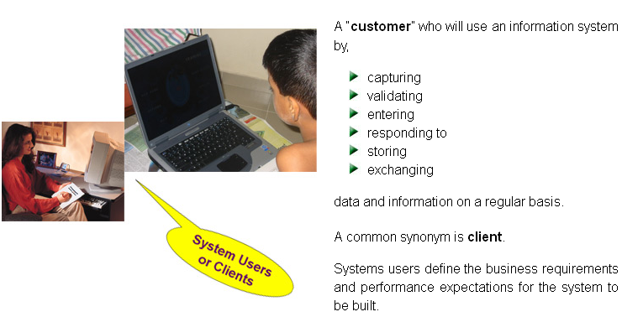
Systems User

Slide 15
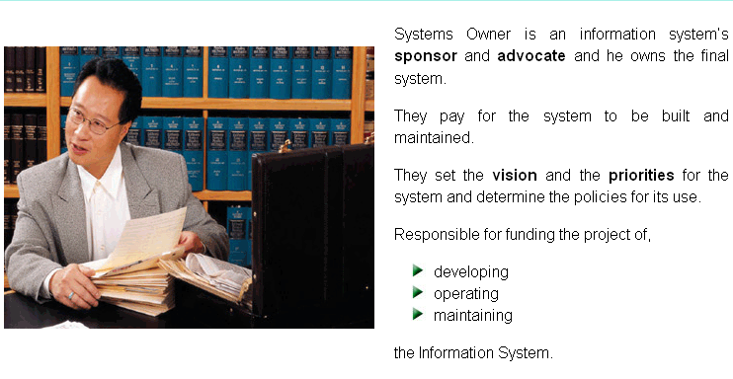
SystemsOwner

Slide 16
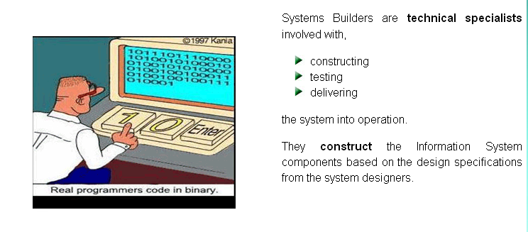
System builder

Slide 17
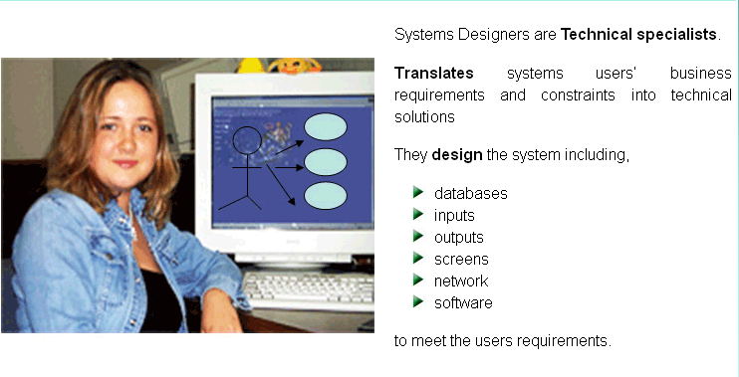
Systems Designer

Slide 18
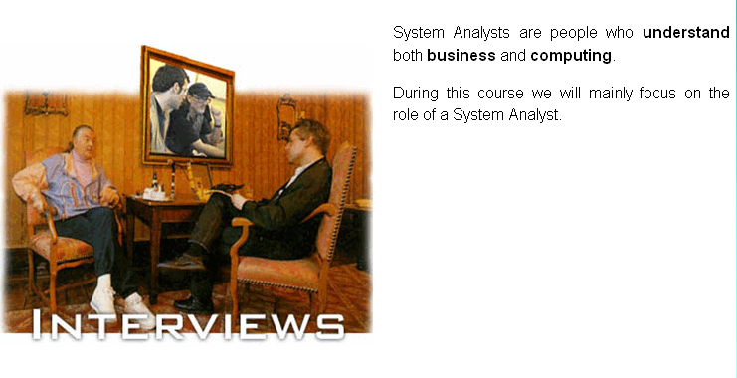
Systems Analyst

Slide 19
Legacy Systems
Legacy system is an "antiquated“ system. potentially problematic
1. often run on absolute hardware
2. spare parts for such computers become increasingly difficult to obtain
3. hard to maintain, improve and expand
4. The designers of the system may have left the organization, leaving no one left to explain how it works.

Slide 20
Upgrading a Legacy System
Many complex legacy systems are yet to be upgraded to new technologies because of Cost, Skills, People required
Force to change–to reflect new or changing business requirements.
Year 2000 problem (Y2K)
Euro conversion

Slide 21
Type of information System
Transaction Processing System (TPS)
Management Information System (MIS)
Decision Support System (DSS)
Executive Information System (EIS)
Expert Systems (ES)
Communications and Collaboration Systems
Office Automation System

Slide 22
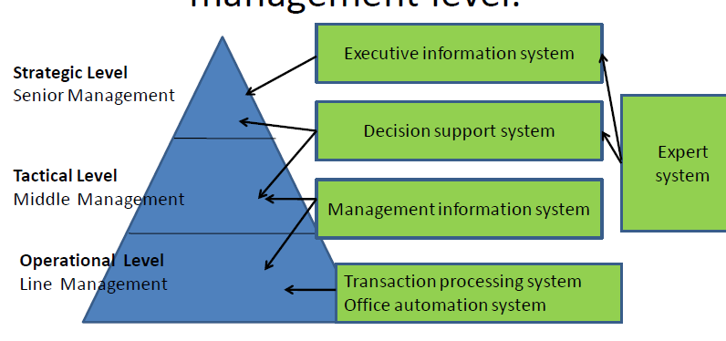
The use of information systems by management level.

Slide 23
Transaction Processing System (TPS)
Information Systems that capture and process data about business transactions.
Used mainly by operational level employees

Slide 24
Management Information System
MIS is an information system application that provides for management oriented reporting.
lower and middle management can control, organize and plan more effectively and efficiently.
Organizations can achieve competitive advantages by effectively using the information generated by the MIS.

Slide 25
Decision Support System (DSS)
Provides its user with decision-oriented information whenever decision making situation arise.
They are interactive systems that assist a decision maker when faced with unstructured or semi structured business problems.

Slide 26
Expert Systems (ES)
An expert system is a programmed decision making information system.
It capture and reproduces the knowledge and expertise of a decision maker and
Simulates the “thinking “ of the expert.

Slide 27
Communications and Collaboration Systems
An IS that enables more effective communications between,
Workers
Partners
Customers
Suppliers
Enhance their ability to collaborate

Slide 28
Office Automation System
It supports the wide range of business office activities. Work group computing
Work group scheduling
E-mail
Electronic document

